Slide 1

A new online resource for children and young people in Wakefield

Slide 2


A new online resource for children and young people in Wakefield
“A new online resource for children and young people in Wakefield”
Contents…
Introduction…
Background on WF-I-CAN
Children and Young People involvement
Brief website tour
Examples of content
Interactive elements of WF-I-Can
GDPR and confidentiality statement
Drop in and chat
Quiz
WF-I-CAN…
was created as a partnership project between Wakefield Council, VCSE and Public Health. Young people told us that they didn’t know what services were available for them and that they would benefit from ideas on how to improve their wellbeing being made easily available in one place.
Most importantly, they wanted to be involved in what came next!
The aim of WF-I-Can is to work alongside children and young people, to provide them with an online resource to help improve their overall wellbeing (emotional, mental and physical).
The site includes ideas developed by children and young people themselves, helps to connect them with local and online services and offers a Drop in and Chat service with a support worker Monday to Friday 1-5pm and 7-9pm.

Slide 3
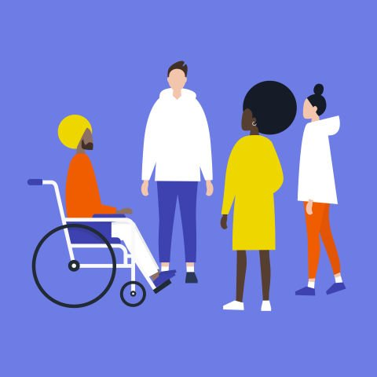

A new online resource for children and young people in Wakefield
“WF-I-CAN is a place to find information and advice as well as self-help tips that can increase confidence and resilience.”
What came from the meeting?
1) The need for a safe space where young people can access support and activities to improve their wellbeing.
2) The need to improve the visibility of local services that are available for children and young people.
How did WF-I-Can come about?
Building on ongoing work throughout the year, a group of 30 local children and Young People organised an event, assisted by Young Healthwatch. With the support of HQ Arts and the Youth Service, the event enabled young people from across the District to come together and share their views of local services. The young people included members of Stripes Youth Group, the Pupil Referral Unit, Young Carers, children in care and young people with disabilities.

Slide 4
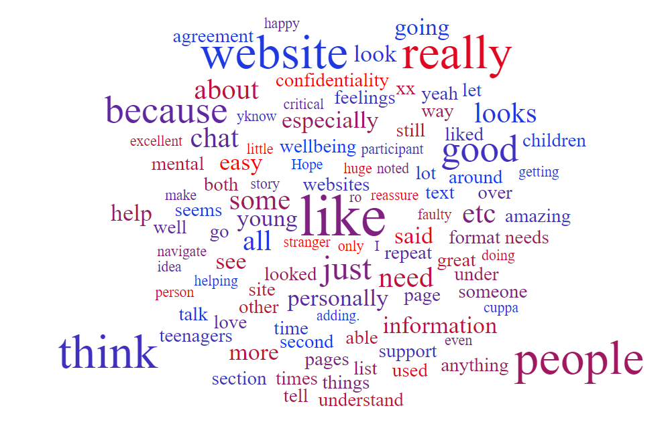

A new online resource for children and young people in Wakefield
Young Peoples Feedback
Children and Young People throughout the Wakefield District were
involved in every stage of creating WF-I-Can.
All content and resources are written by workers in the Wakefield District and approved by relevant organisations, experts/ professionals, and most importantly the children and young people that have identified the need for this service.
We wanted to create a platform that made sure that the voices of local children and young people were heard and valued at every stage.
Most of the content was gathered from groups of children and young people and top tips created through their lived experiences.
“Thanks for this you doing an amazing job and we really appreciate it… For the over 13's website we really liked the page you did for young carers and would like to see that format used in the other areas. We also wondered if we could have the links at the bottom logos similar to Mindmate.”
“We’ve just had the improvement group, only 2 participant and 2 of our most critical!!!
They love WF-I-Can, they have had a brief look and feel the young people have been
listened to.”
“It looks good and it is easy to understand how to do and how to get support”

Slide 5
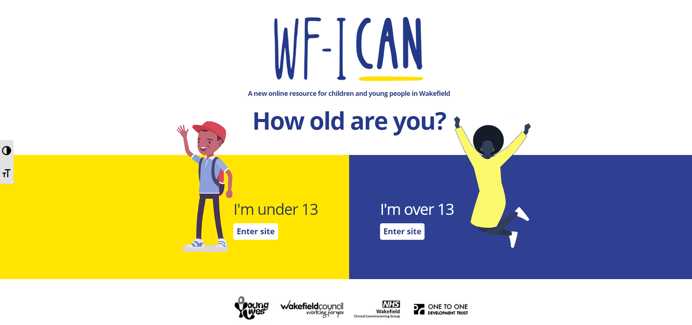
A new online resource for children and young people in Wakefield
Who is WF-I-Can for?
Any child or young person in the Wakefield District, aged 8-19 years.
It is split into different, easy to navigate sections, which we will now explore…
How old are you?
The first page on the website is an age gateway. This is because all sections of the website and its content are tailor- made for either 8-13 or 13-19 years.
Children and young people agreed that the content would make more sense to them and be of more value if it tweaked to specific age groups- it would help young people understand the topics better.
As well as the written content, the illustrations and graphics, activities and downloadable worksheets are all tailored by age on each part of the site.

Slide 6

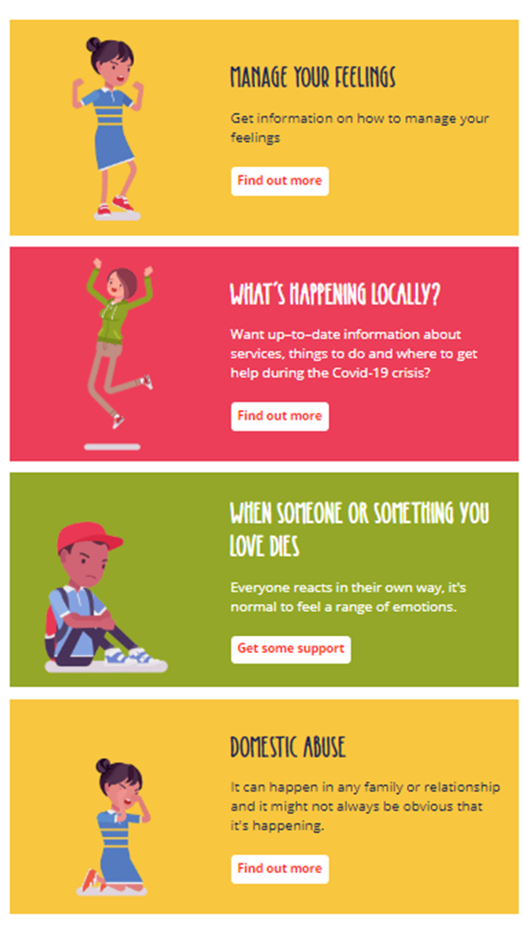
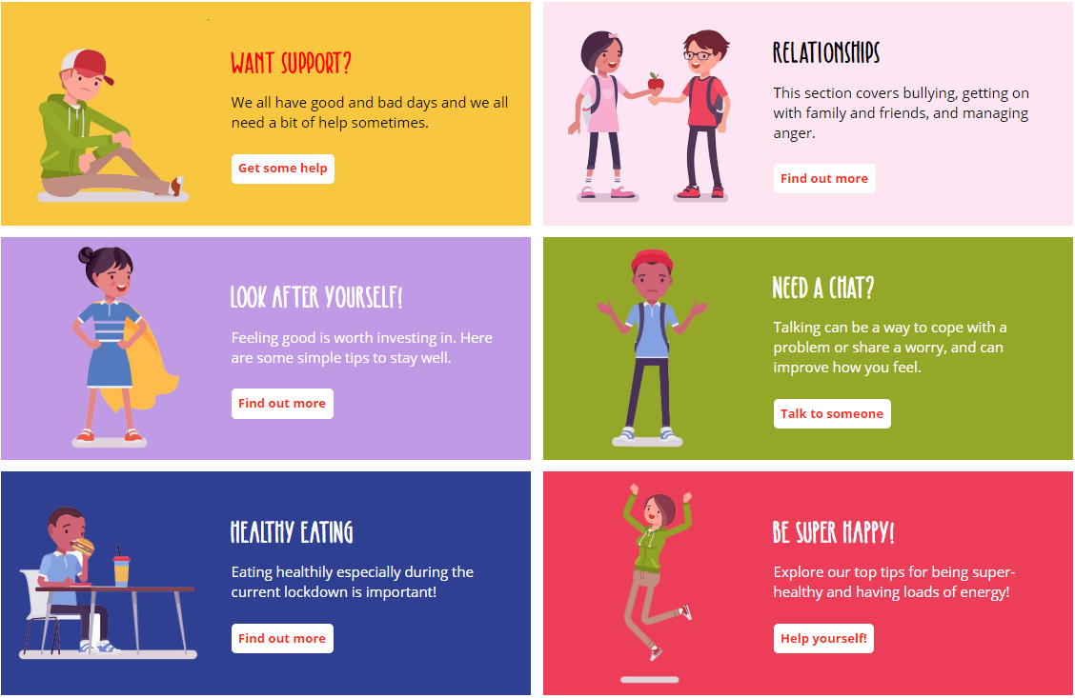
A new online resource for children and young people in Wakefield
tour
For example…
Under 13
Want support?
Sections are full of advice and resources.
What’s happening locally gives easy to understand information on current Government guidance on the Coronavirus pandemic.
Sections that are more focused on one particular topic were written with the help of specialist local organisations and professionals.
Each different section aims to cover all aspects of wellbeing; emotional, mental and physical. Above are the six main headings of the Under 13 area of the website.

Slide 7
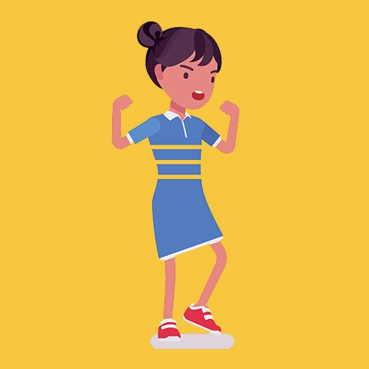
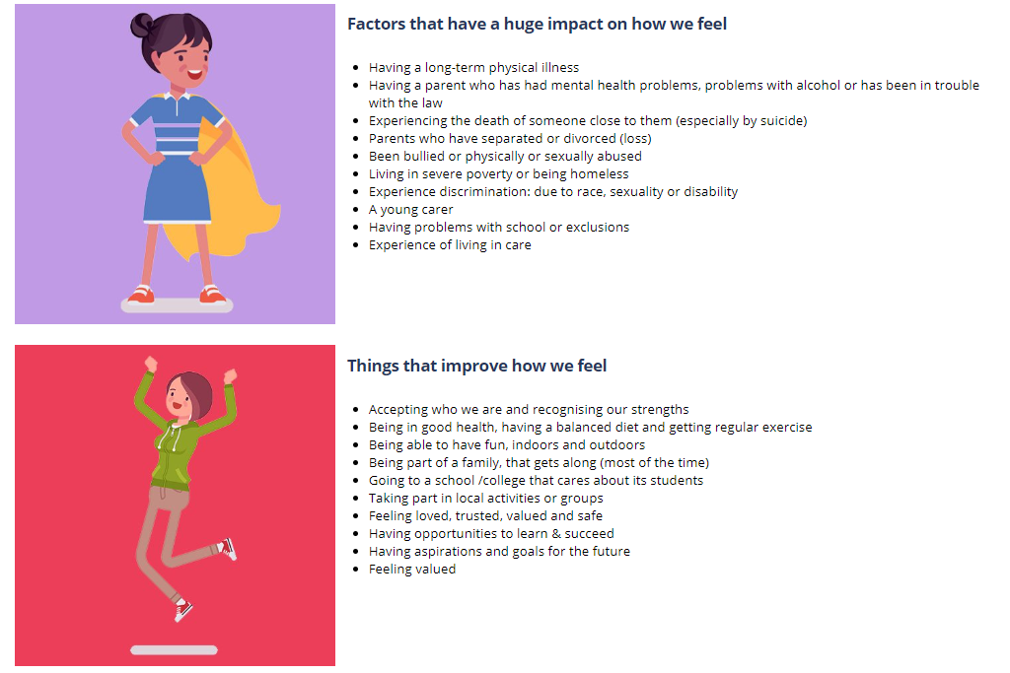
A new online resource for children and young people in Wakefield
Some feedback from the initial design period…
Here is an example of some information on the Managing your Feelings page.
Information is laid out in short sentences so that it is easy to read.
“I looked at the templates for both websites and they look amazing. I think they very well communicate with the target users and attract them to the website. Furthermore, I believe this is a great way to help young people and protect their mental health in this difficult time of the COVID-19 Pandemic. This will reassure them despite not being able go out of the house, they still have a variety of options and people to talk to if they need to discuss their feelings or need to talk to someone regarding their mental or physical wellbeing.”
“I thought that all of the websites were excellent. The under 13s looks fantastic, I personally think that the second version looks much better and organised simply because of the rows but that is just a personal opinion. Maybe the under 13s website could cover a range of activities to do whist they are at home.”
“I was really impressed with the over 13s website, because both ages have a
plentiful amount of resources for children to refer to if they ever need anything . I think the idea of helping children to understand family conflict is ingenious, especially since families will be spending more time together given the current circumstances.”
“Really good liked all the pages and information on them a lot of it. Not too
wordy no big words. Like the colours used on the website.”
“yeah I look at the website and it has some good information on there the first place I looked was the bullying section and I think that is going to help a lot of people xx I like the way it's set out it makes it very inviting xx”
“I found the website brilliant – no faulty buttons and it was very encouraging! I made the box.”

Slide 8
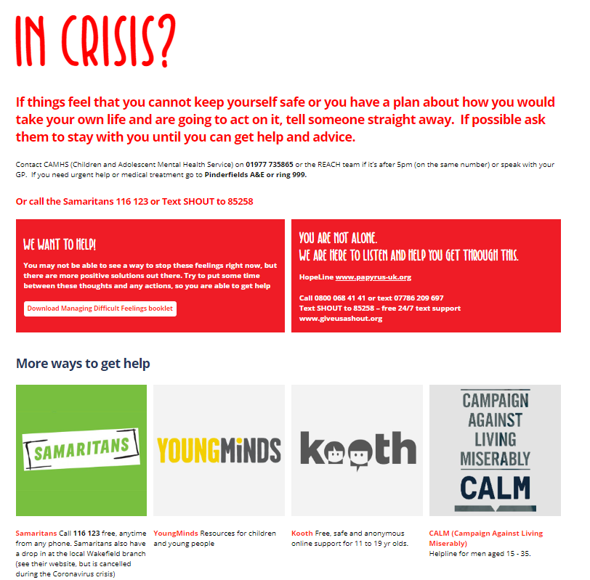
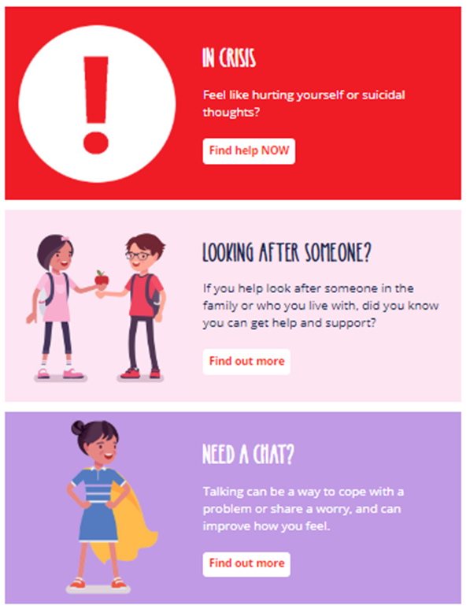
Want support?
The crisis button is an important feature of the website and is present on every page of the site, either as a large red button or as a tab on the menu bar.
As WF-I-Can is NOT a crisis or counselling service, we made sure that information and links are easily accessible throughout the site.
It was really important that the site was also full of relevant links to services that can help children and young people with further information on certain topics.
Our Drop in and Chat service is available Monday- Friday 1-5pm and 7-9pm. You can have a chat about anything you feel like with one of our support workers.
Continued…

Slide 9
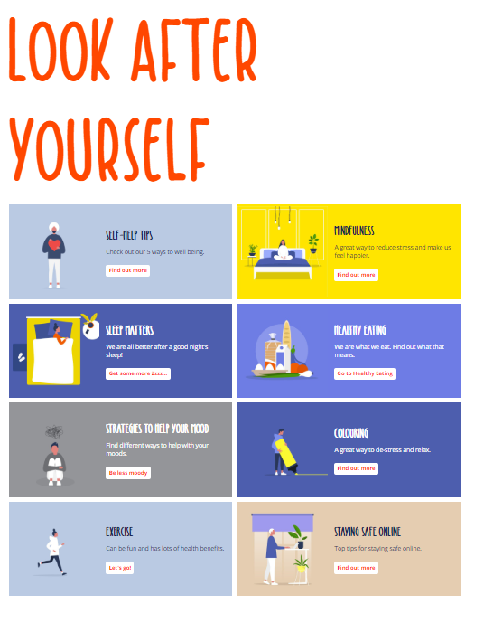
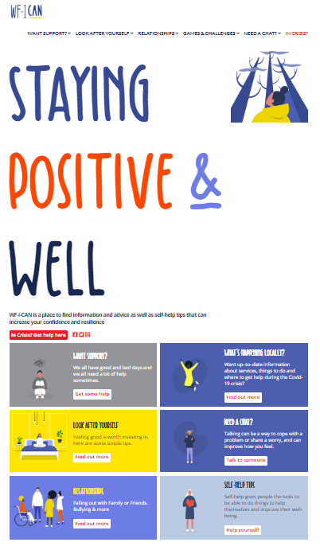
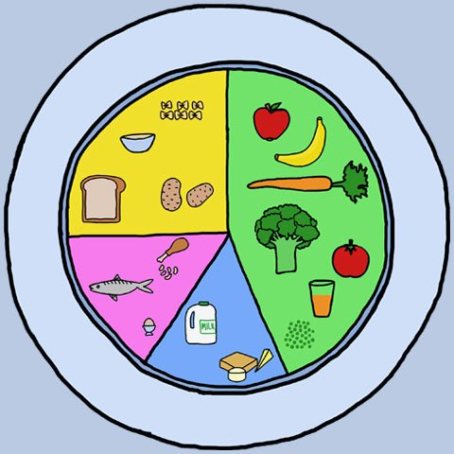


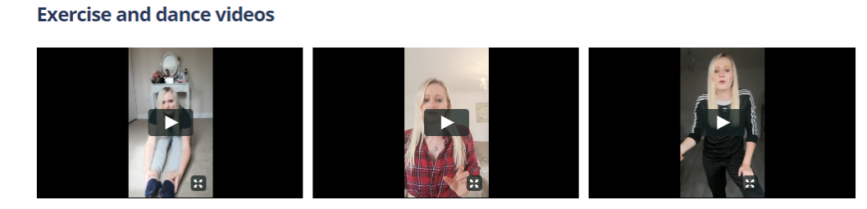
Over 13
Examples of some content

Slide 10
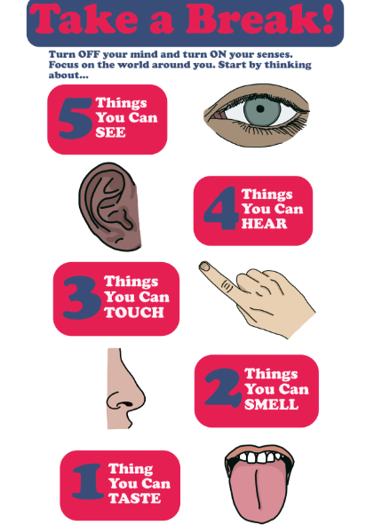
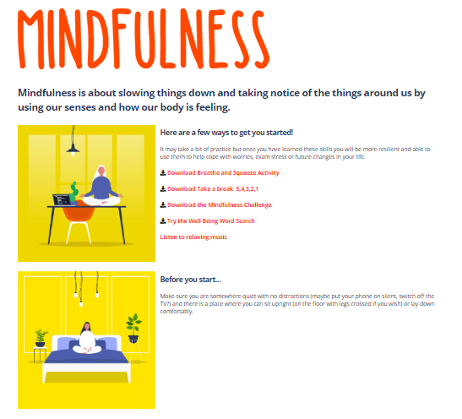
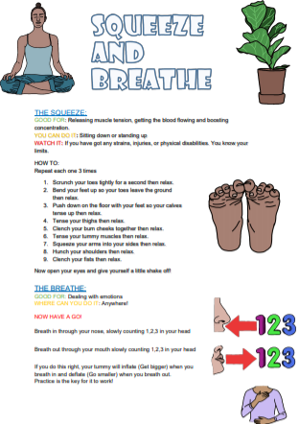
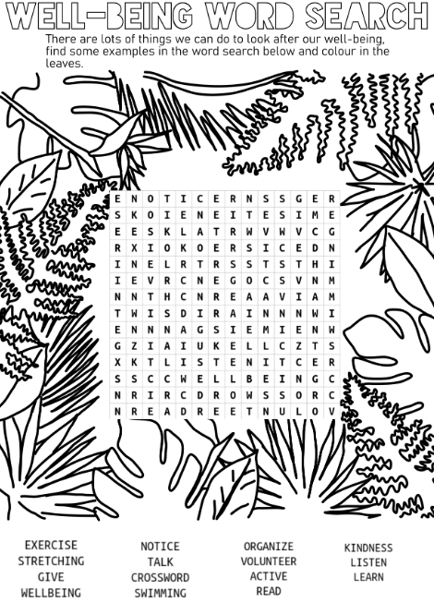
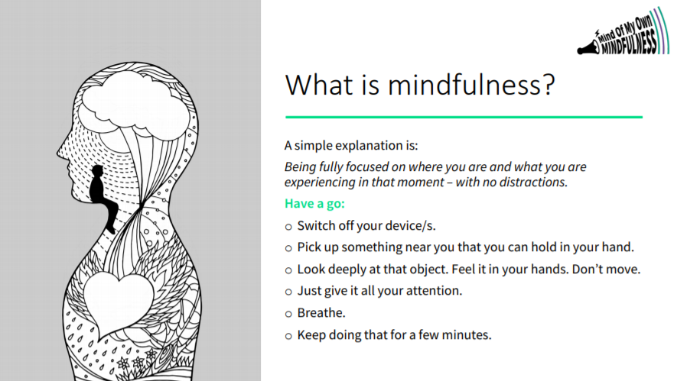
For example…
A new online resource for children and young people in Wakefield
Downloadable
resources…
“It was really easy getting around the site, and I like that they have separate
pages for younger kids and teenagers. They've got an extensive list of
articles for self help which is great, because it means that teenagers can
be independent, which I think is personally a confidence booster. It
promotes good habits, and shows little things can have a huge impact on
our mood.”

Slide 11
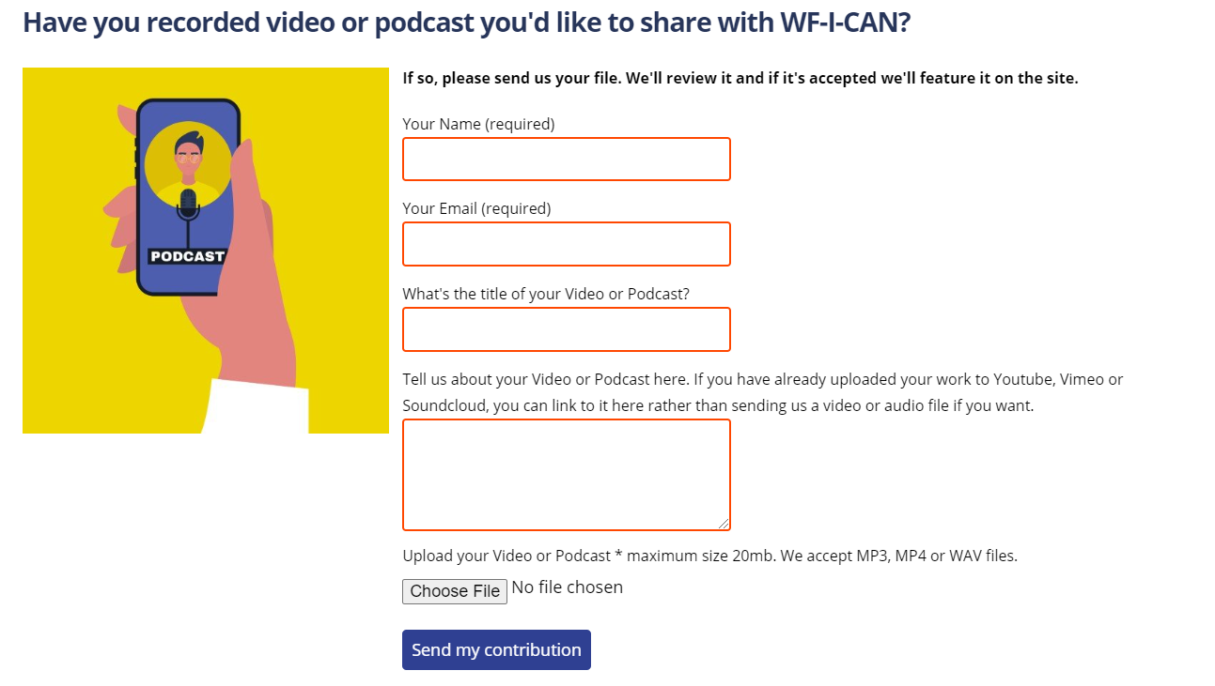
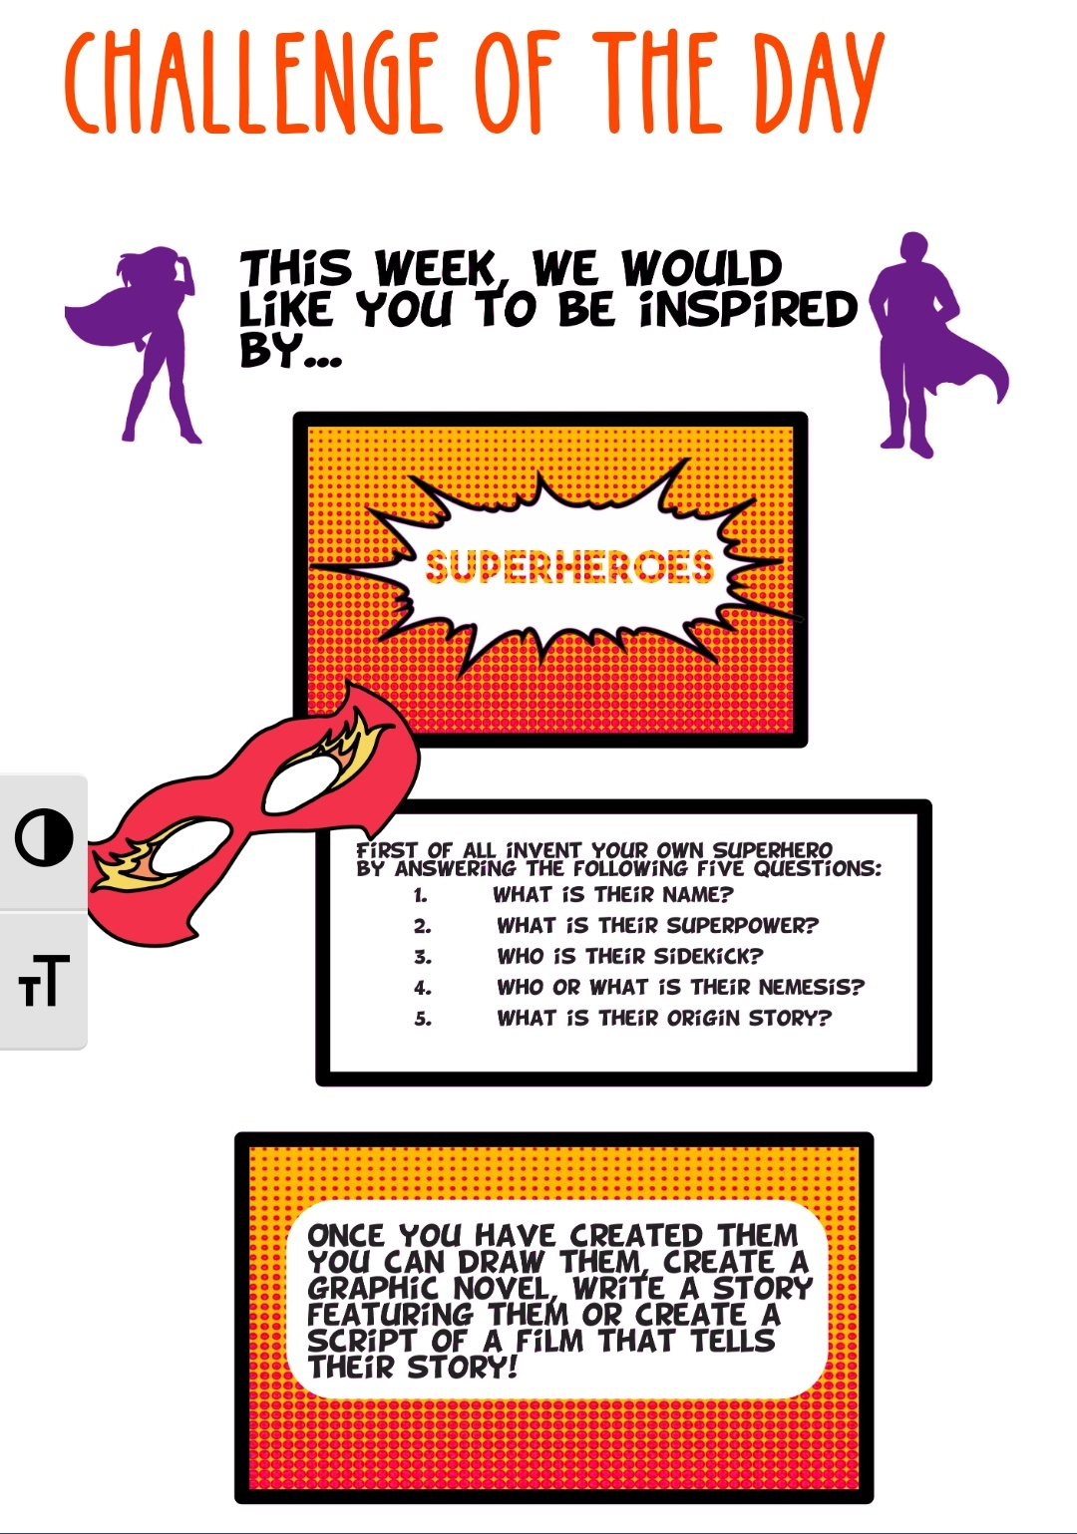
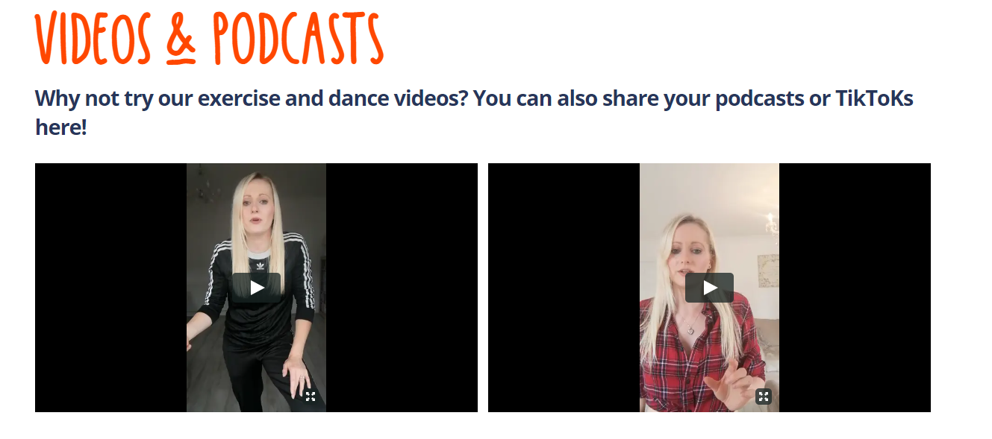
Interactive
elements…
A new online resource for children and young people in Wakefield
Every week the website is updated with a weekly challenge.
These are sometimes different for the under and over 13’s sections.
Children and Young people are encouraged to join in and share their weekly challenge creations.
Weekly challenges are created by Community Navigators and local organisations.
There are a range of different themes and activities, to encourage children and young people to be creative, involved and engaged in activities they may not normally do.
The site has many other interactive elements such as a Podcast section. Children and Young people can upload Podcasts or TikToks via this submission form, which will be featured in a gallery page.
Dance tutorials are uploaded on the Videos and podcasts page from a local dance teacher called Claire.

Slide 12

A new online resource for children and young people in Wakefield
How does it work?
You will need to “sign in”
We need your name and age so we know who we are talking to and that we can show our funders we are working with young people. This information can also help us in case there was some sort of emergency.
(I agree to you keeping this information: Yes /No)
*If yes, you will need to give us permission to keep your details
(GDPR Form: Yes, I agree)
The Children’s Act 2004 states that we must make sure all children and young people are safe. If we are worried about your safety, we will ask your name, where you are and for you to provide a telephone number or email address.
In line with Public Health we also need to make sure that you can find help easily from a source you can trust. By providing early intervention information we aim to protect and improve children and young people’s emotional well-being and reduce inequalities.
Some of our services are intentionally targeted at children age 13 years of age and younger as it has a separate platform and entry on the portal. We only collect and maintain the data to use for monitoring purposes for funders and safeguarding. This is in line with Government guidance.
The ICO Key Data Protection themes ‘At a Glance’, states:
"For children under this age you need to get consent from whoever holds parental responsibility for the child - unless the online service you offer is a preventive or counselling service."
From the ICO Guide: The UK’s independent authority set up to uphold information rights in the public interest promoting openness by public bodies and data privacy for individuals.
If we need to tell someone about what’s happening, we might use your IP address (the number used by your internet provide), to get you help.
*If you refresh the chat website page while you are waiting you may lose your place in the queue and must sign in again.
When it is your turn to chat to a Support/ Youth Worker, you will receive a message from us to let you know (“Hi [name]”)
Our youth worker will introduce themselves and you can start to chat.
We look forward to hearing from you!
“WF-I-CAN offers a virtual drop-in to anyone between the ages of 8 and 19 years old, a safe place where you can chat to one of our youth workers. So, if something is worrying you or you want to share some good news, then message us. WF-I-CAN is not a counselling service but we are here to listen and signpost you to support if needed, as well as tell you about activities to try at home to help you cope with the current lockdown.”
Will you tell anyone I’ve messaged?
We do not contact parents or anyone else if you message us unless we are worried about your safety or someone else’s, and we would usually speak with you first.
How long will each chat last?
Each chat will usually last up to 30 minutes as there may be other young people waiting. But you are welcome to message back another day as we’d love to hear how you are doing.
When can I chat?
We are online Monday – Friday (1pm – 5pm and 7pm - 9pm)

Slide 13
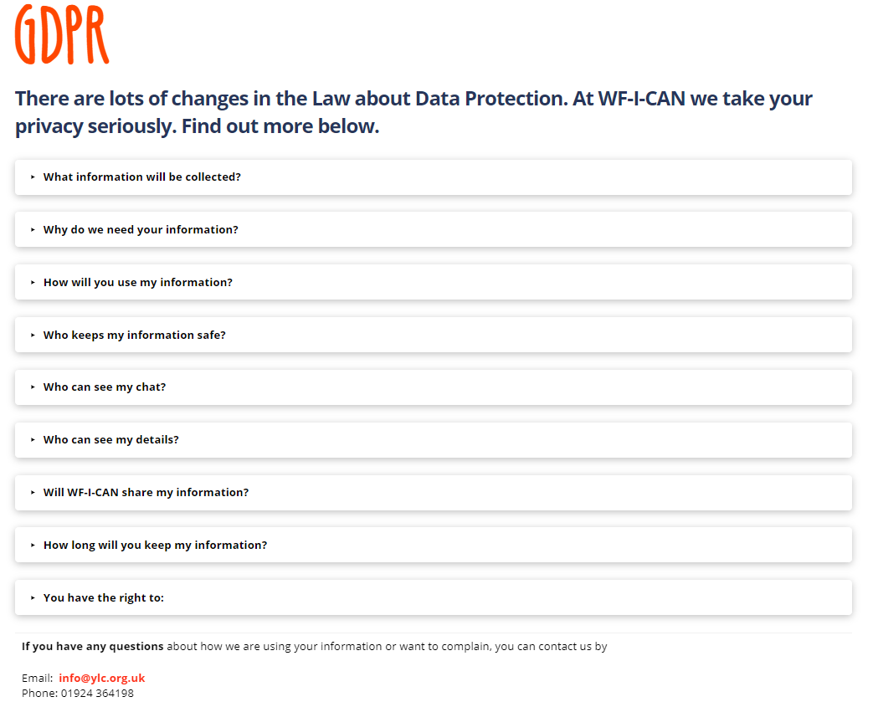
Drop in and chat
A new online resource for children and young people in Wakefield
What information will be collected?
To use our ‘drop in and chat’ service we need your
Name
Age
Contact details - such as email, mobile (optional)
Why do we need your information?
So our youth workers have an idea who they are talking to. We have a duty to keep all children and young people safe, if we need to get help to you it is quicker if we have your details - we can re-read your notes when you contact us again to make sure we can give you the best help. Youth workers are here to listen to you for whatever you need. We need to show our funders (who have paid for the website) that it is being used by children and young people.
How will you use my information?
If we are worried you or someone may be in danger or at risk we might use your mobile, email or IP address (the number used by your internet provider) to get help to you. It will be part of the data in the monitoring reports we do for our funders. We will not use your name or contact details.
Who keeps my information safe?
Young Lives Consortium is the ‘Data Controller’ who keeps this information safe. We will do our very best to keep your information secure. Any written recordings will be kept securely within a locked filing cabinet in private office.
Who can see my chat?
Only you, the youth workers in the ‘chat’ and the website safeguarding leads.
Who can see my details?
Our podcasts and gallery are public, so we will ask for permission before anything is posted on the website that you send in.
Will WF-I-Can share my information?
The only time we will do this is if we think you or someone else is at risk or if you give us consent to share with a named person or service.
How long will you keep my information?
Your details will be kept securely on the website to keep it safe for 12 months or unless you ask us to remove it. Chats are deleted after 30 days (unless the information may be about child sexual abuse or a safeguarding concern).
You have the right to:
see any information we hold about you
tell us if the information is wrong so we can change it
ask for your details removing
complain

Slide 14
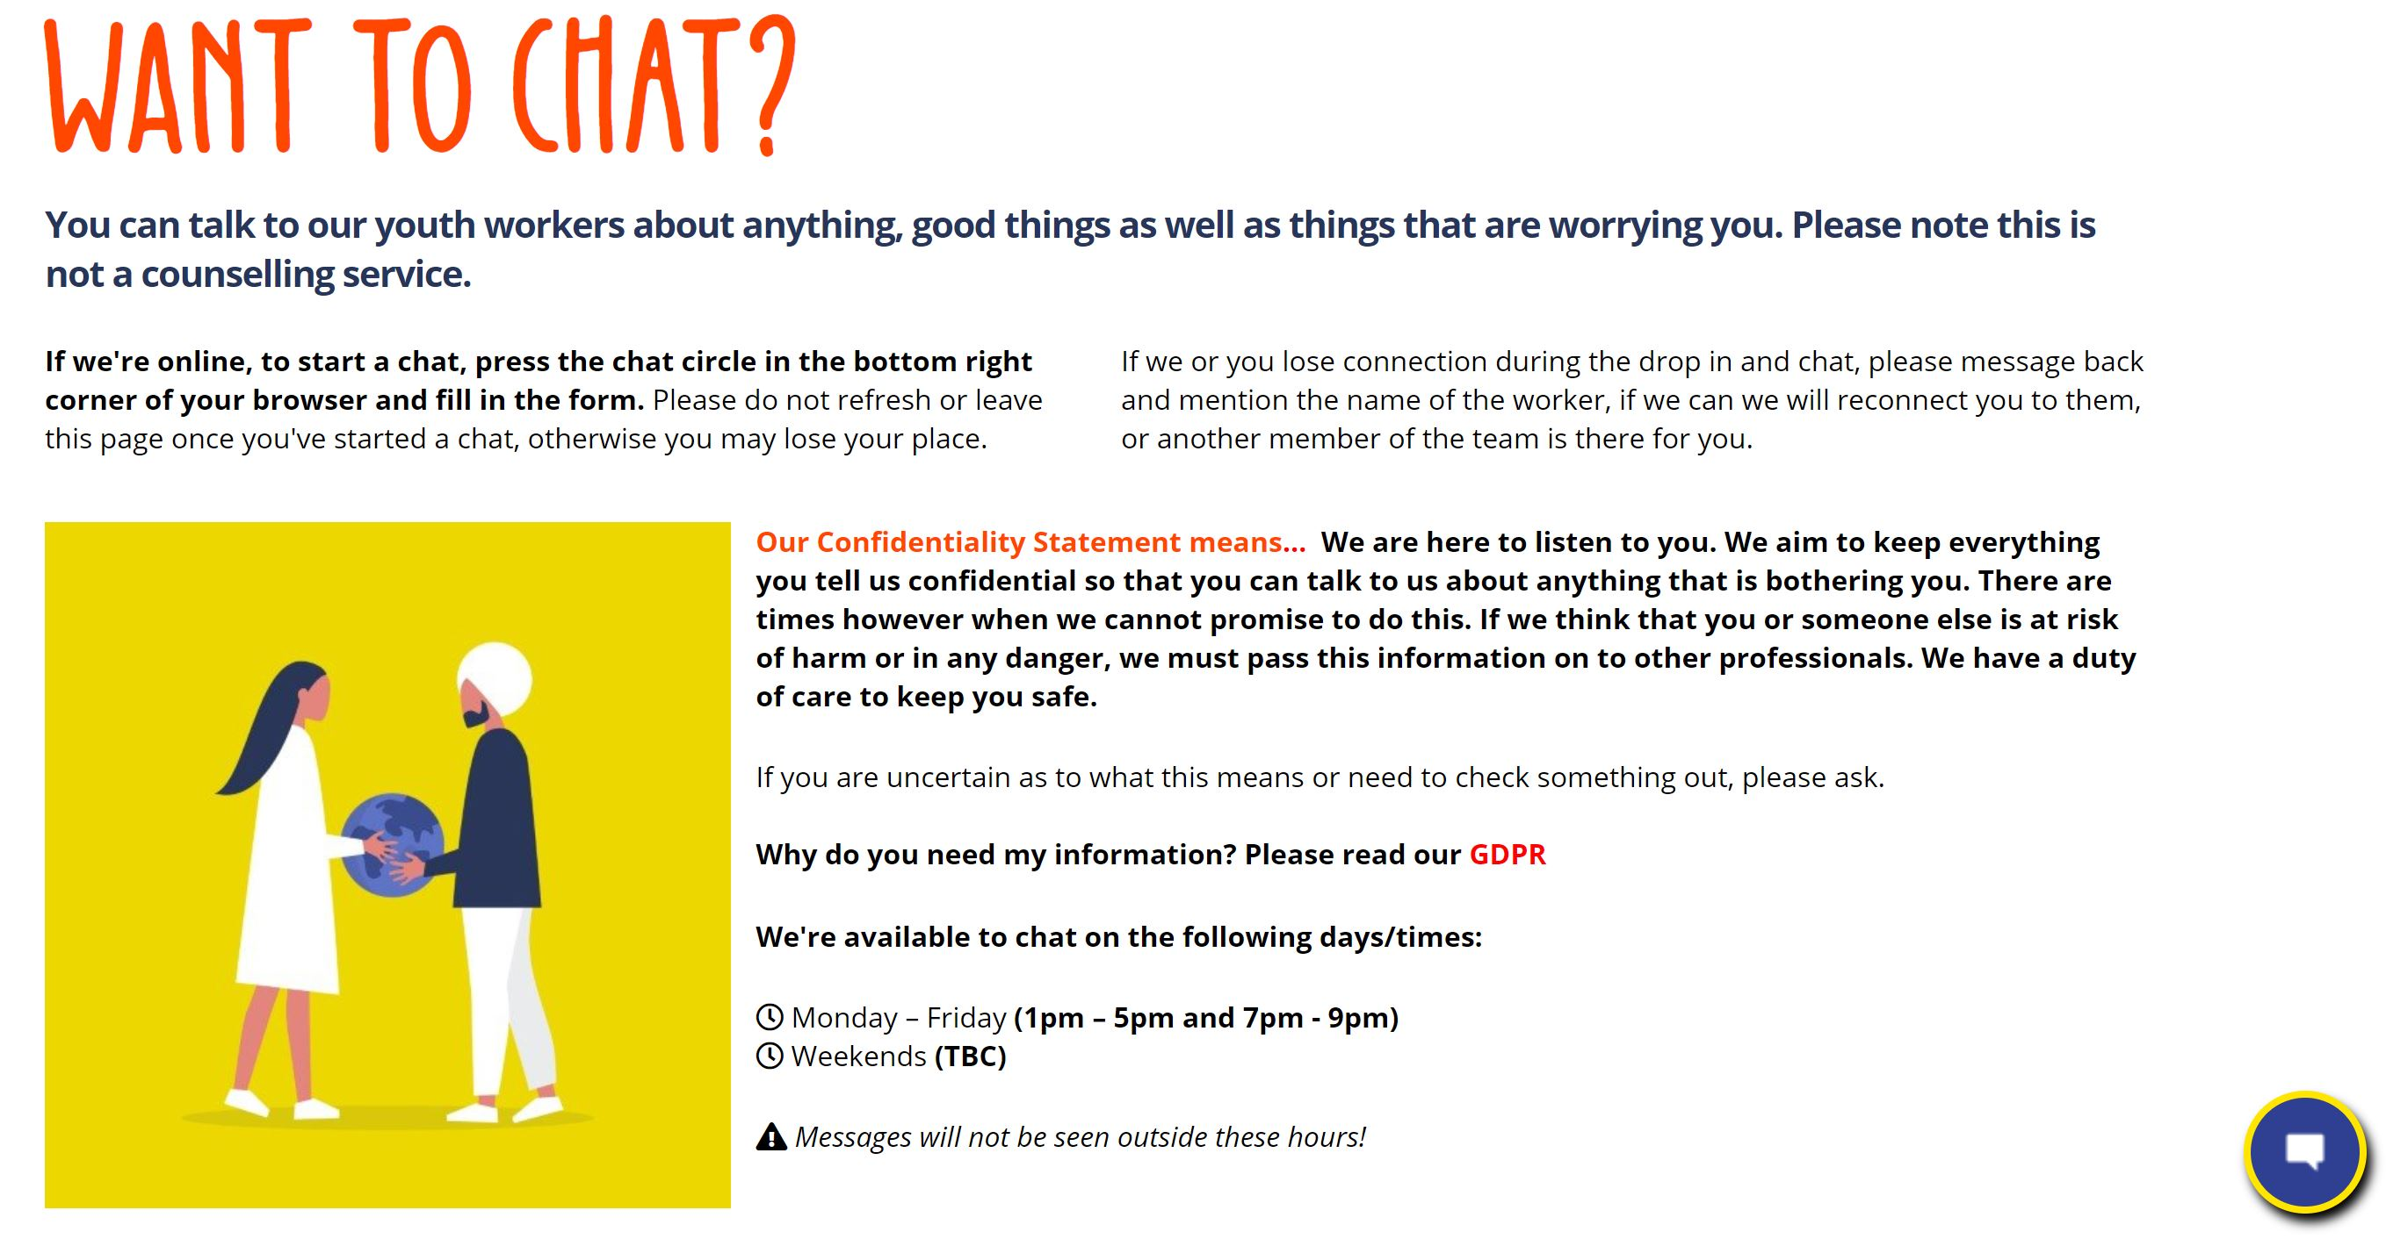
Drop in and chat
A new online resource for children and young people in Wakefield
Young person: “the website seems good and it has all the information in it that is needed, it is easy to get around and everything is labelled where it needs to be so then you know where you are and where you can go from that page etc. even though you have on "Live chat" section about GDPR and the confidentiality agreement as some people may not think about reading them if they need to speak to someone urgently might think it’s not that important id say underneath the final bullet point just put the confidentiality agreement as then people will be able to see it before they enter the chat, but other than that it all looks good”

Slide 15
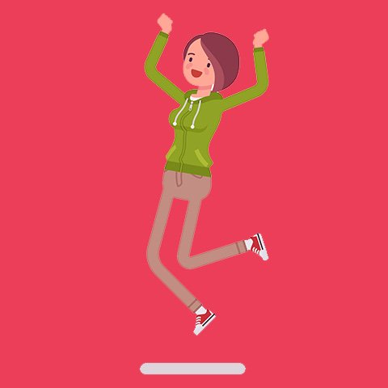

Quiz
Quiz
Under 13
6. In the wheel for strategies to help your mood, what is one of the recommendations?
7. Can you name three “sleepy foods”?
8. What times and days is the Drop in and Chat available?
9. What is the free phone number for the Samaritans?
10. Name two ways anger can affect your body.
11. What is the name of the organisation that advises young people on how to stay safe in domestic abuse?
What are the Five Ways to Wellbeing?
Name an organisation that helps young carers.
What is the mindfulness app called that is recommended?
What is the Challenge of the Day?
Name one website you can find out more about healthy eating from.

Slide 16

Answers
nline resource for children and young people in Wakefield
Answers
Under 13
Give, keep learning, be active, take notice, connect
Young carers youth group, Youth work team, Barnardos WESAIL, School nursing, Young Minds, Carers UK, Young Sibs
Breathe App
A challenge that is updated every week, some are creative and some get you to think outside the box etc.
Change 4 Life, Mindmate, Health for kids!
Focus on breathing, write journal or draw how I feel, listen to my favourite music, exercise, call or talk to my trusted adults, stop and think about what I am feeling, squeeze a stress ball.
Milk, meat, fish, cheese, fruits, vegetables, nuts, seeds, legumes, grains, bread.
Monday to Friday, 1pm-5pm & 7pm-9pm
116 123
Knots in your stomach, Clenching your hands or jaw, Feeling clammy or flushed, Breathing faster, Headaches, Pacing or needing to walk around, “Seeing red”, Having trouble concentrating, Pounding heart , Tensing your shoulders.
The Hideout

Slide 17
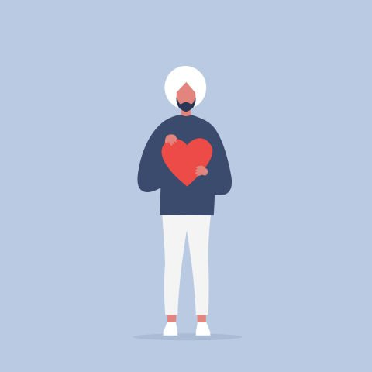
A new online resource dfor children and young people in Wakefield
Thank you for your time

Slide 18


Slide 19
Contact Details
Debbie Tolson – Community Navigator (North West)/Team leader – debbie@ylc.org.uk
Marie Rafferty – Post 16 lead/Team leader – marie@ylc.org.uk

